Slide 1
Liver Disorder
Presented By:
Masadi Swetha
2203A52102
AiML-A
To:
Ramesh Dadi
Faculty of STATML

Slide 2
About Data set :
Name of the data set:
Indian Liver Patient Records
Data set taken from:
https://www.kaggle.com/datasets/uciml/indian-liver-patient-records

Slide 3
PROBLEM STATEMENT:
By using these patient records to determine which patients have liver disease and which ones do not.
INTRODUCTION:
This data set contains 416 liver patient records and 167 non-liver patient records collected from North East of Andhra Pradesh, India. The “Dataset” column is a class label used to divide groups into a liver patient (liver disease) or not (no disease). This data set contains 441 male patient records and 142 female patient records.

Slide 4
Data description
Any patient whose age exceeded 89 is listed as being of age “90”.
Columns
Age of the patient
Gender of the patient
Total Bilirubin:
Bilirubin is an orange-yellow pigment that occurs normally when part of your red blood cells break down. A bilirubin test measures the amount of bilirubin in your blood. It’s used to help find the cause of health conditions like jaundice, anemia, and liver disease.

Slide 5
Direct Bilirubin
Bilirubin attached by the liver to glucuronic acid, a glucose-derived acid, is called direct or conjugated, bilirubin. Bilirubin not attached to glucuronic acid is called indirect
Alkaline Phosphatase
Alkaline phosphatase (ALP) is an enzyme in a person’s blood that helps break down proteins. Using an ALP test, it is possible to measure how much of this enzyme is circulating in a person’s blood.
Alamine Aminotransferase
Alanine aminotransferase (ALT) is an enzyme found primarily in the liver and kidney. ALT is increased with liver damage and is used to screen for and/or monitor liver disease.
Aspartate Aminotransferase
AST (aspartate aminotransferase) is an enzyme that is found mostly in the liver, but also in muscles.

Slide 6
IMPLEMENTATION
Parametric Approach
Classification
Logistical Regression
Perceptron Learning
Support Vector Machine
Bootstrapping with Logistical Regression
Bootstrapping with Support Vector Machines
Bootstrapping with Perceptron Learning

Slide 7
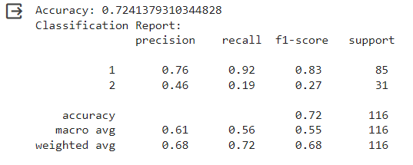
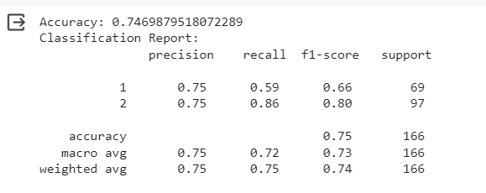
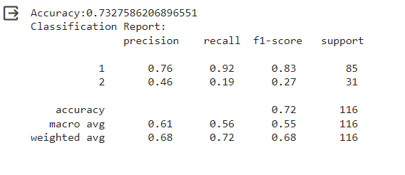
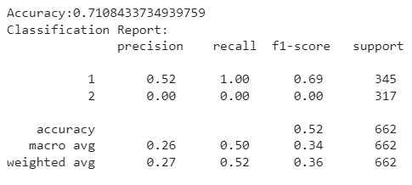
Result Analysis:
For Logistic Regression
Before SMOTE:
For Logistic Regression
After SMOTE:
For svm before smote:
For svm after smote:

Slide 8
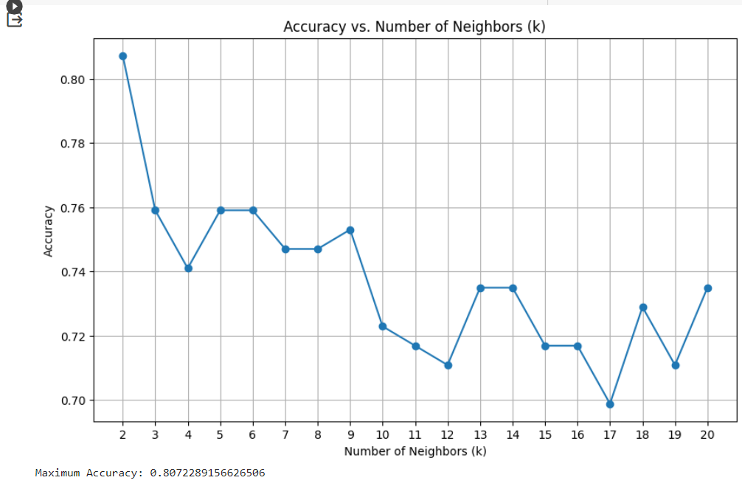
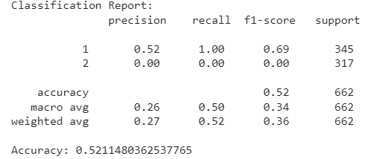
For Perceptron:
For KNN:

Slide 9
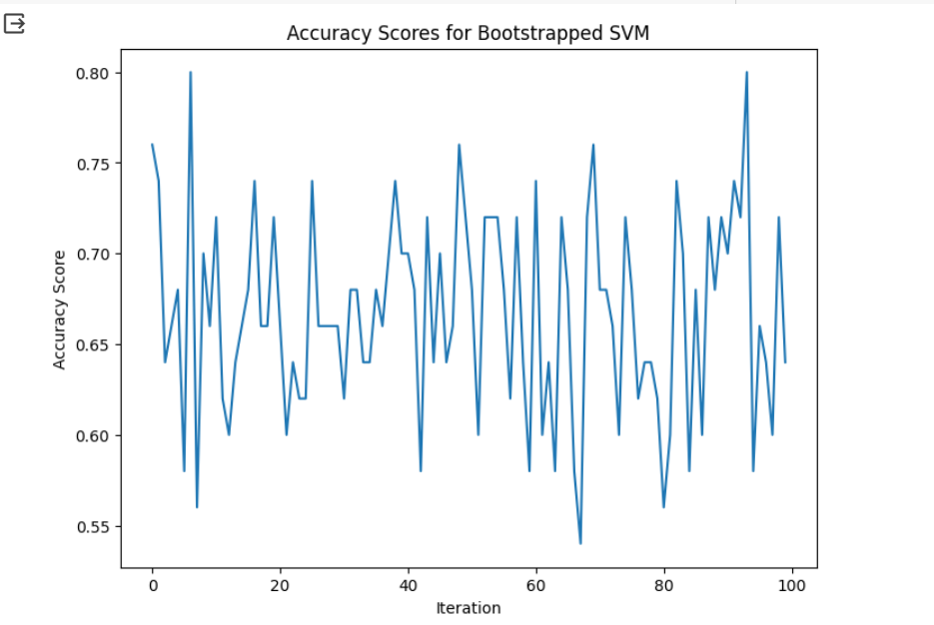
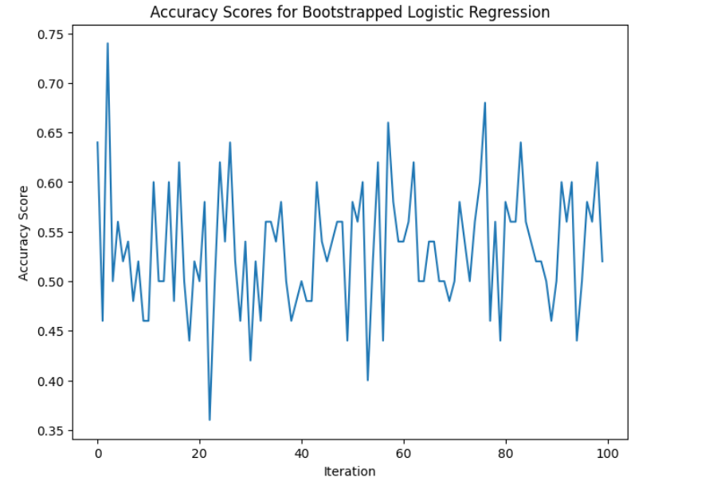
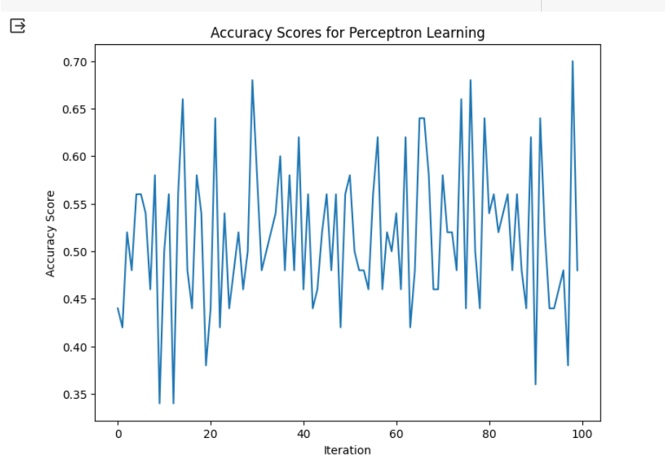
For Bootstrap

Slide 10
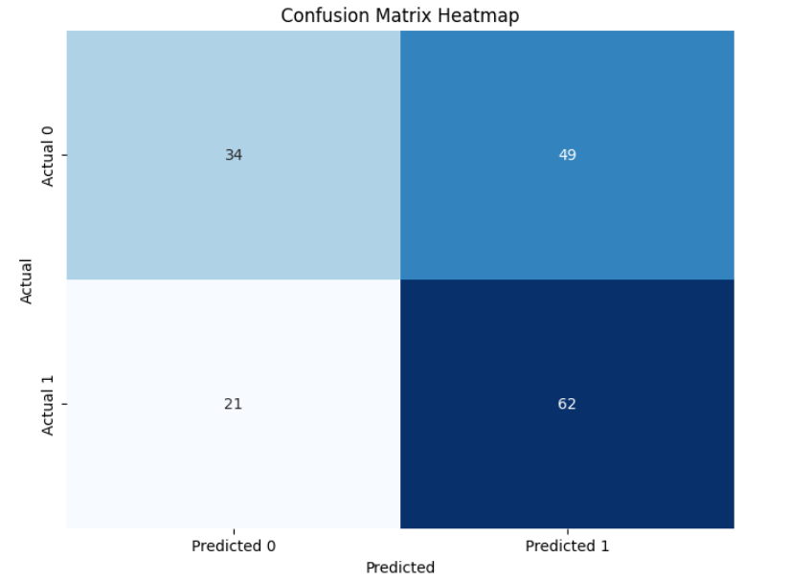
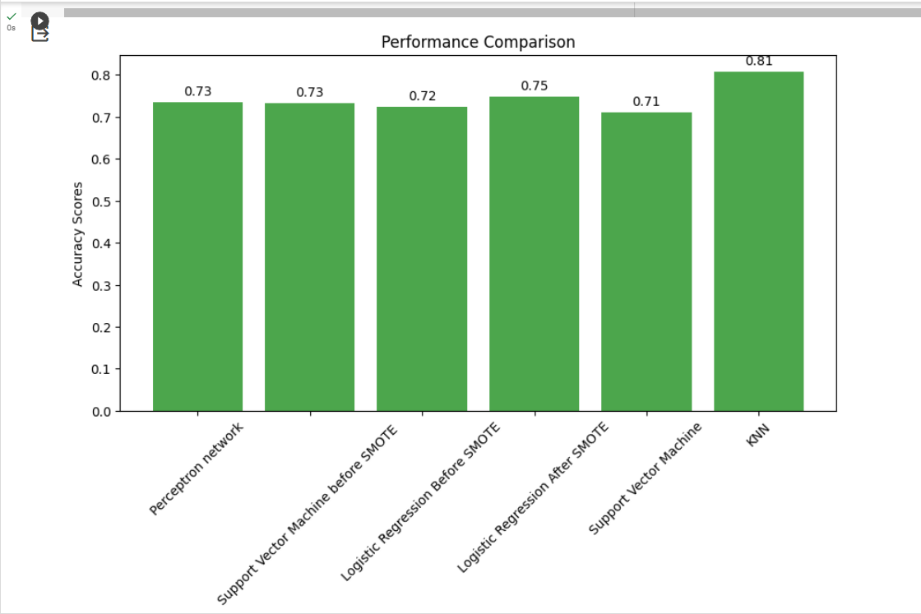
Confusion matrix heatmap:
graph:

Slide 11
CONCLUSION:
Our analysis of the liver disorder dataset has provided valuable insights into the factors associated with liver disorders. We applied Logistic Regression, Support Vector Machine, Perceptron, KNN, Bootstrap to predict presence (yes) or absence (no) of liver disorder. The performance of the models was assessed using metrics such as accuracy, precision, recall, F1-score, which provides a comprehensive evaluation of the model’s effectiveness. We found that the accuracies for “Logistic Regression before SMOTE, Logistic Regression after SMOTE, Support Vector Machine before SMOTE, Support Vector Machine after Smote, Perceptron Network and K Nearest Neighbour” are “0.75, 0.71, 0.72, 0.71, 0.73 and 0.81”.

Slide 12
Thank you

